Slide 1
Aedes Species Identification via
Computer Vision on Mosquito Eggs

Slide 2
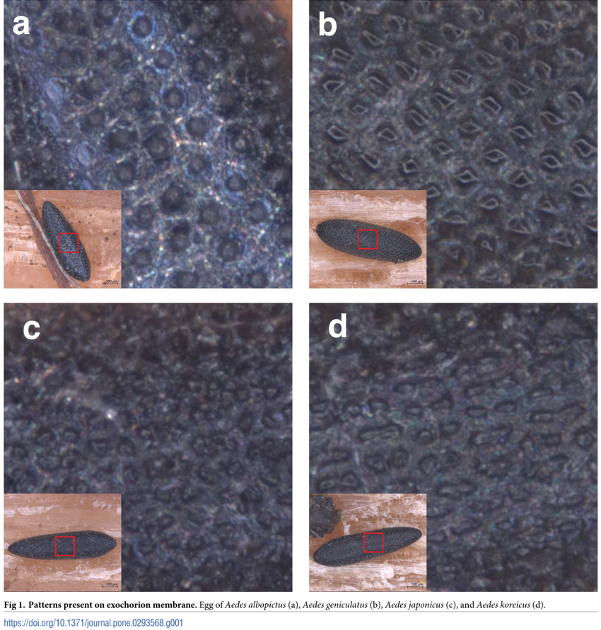
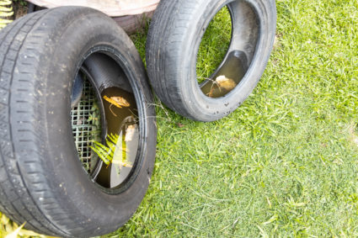
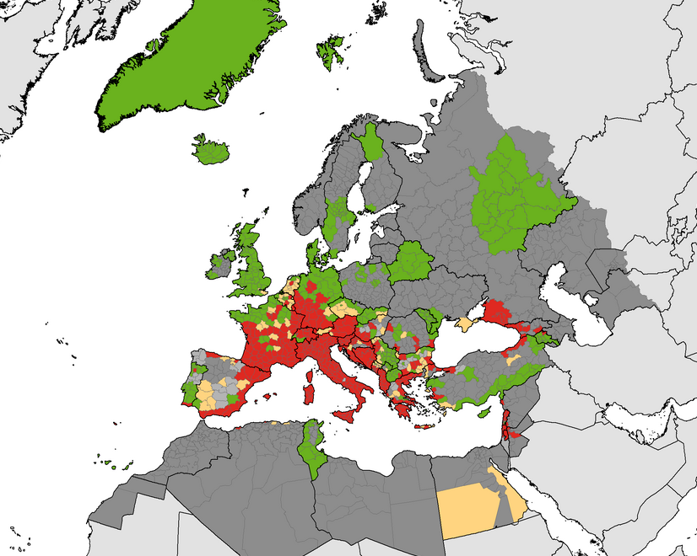
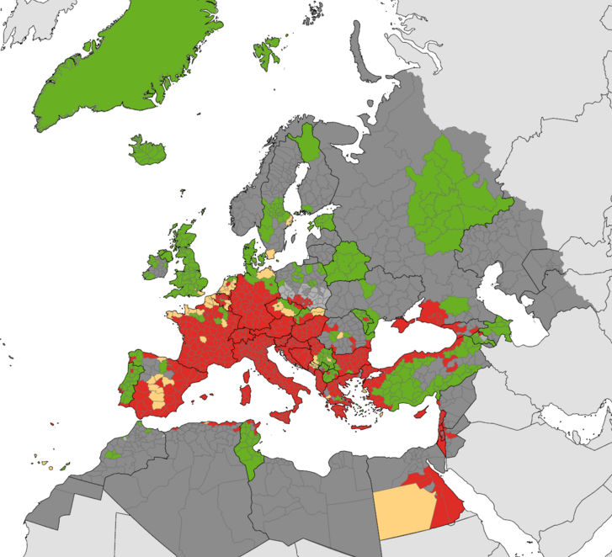
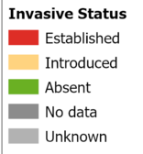
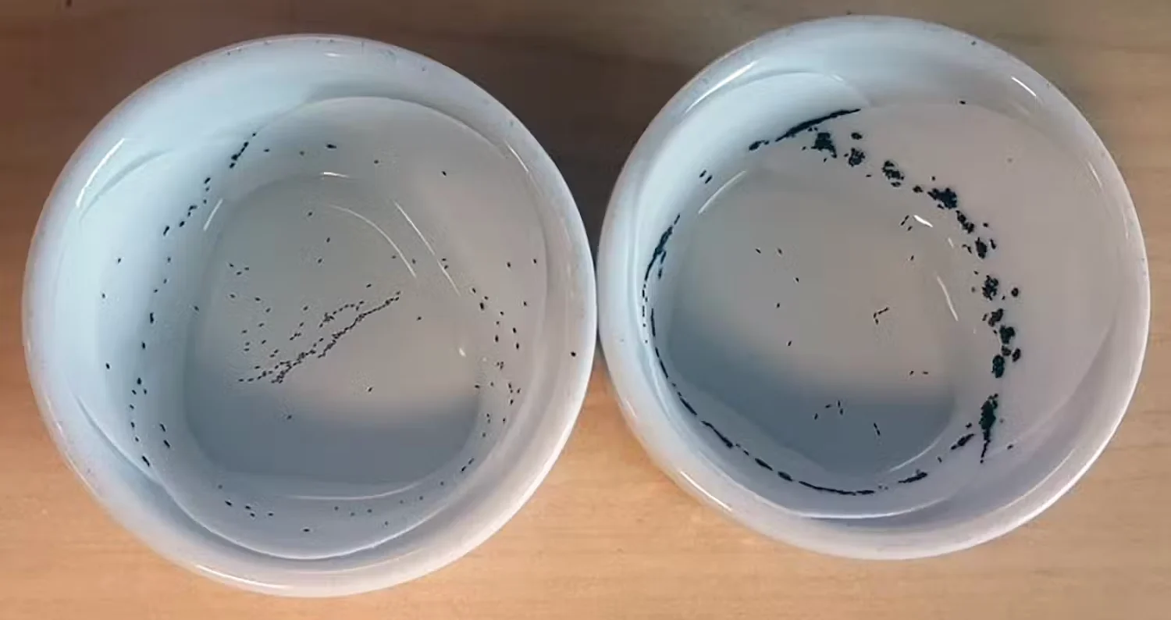
Reasons for the project
Increasing danger from invasive species with multiple diseases
Earliest stage for vector control
Until now egg identification is not feasible
October 2020
June 2025
Distribution of invasive mosquitos (Ae. aegypti, Ae. albopictus, Ae. atropalpus, Ae. japonicus and Ae. Koreicus)
https://www.ecdc.europa.eu/en/search?s=Aedes+invasive+mosquitoes

Slide 3
Main objectives
Different image capture methods
Identification and segmentation of four aedes species
Easy to apply and reliable performance

Slide 4

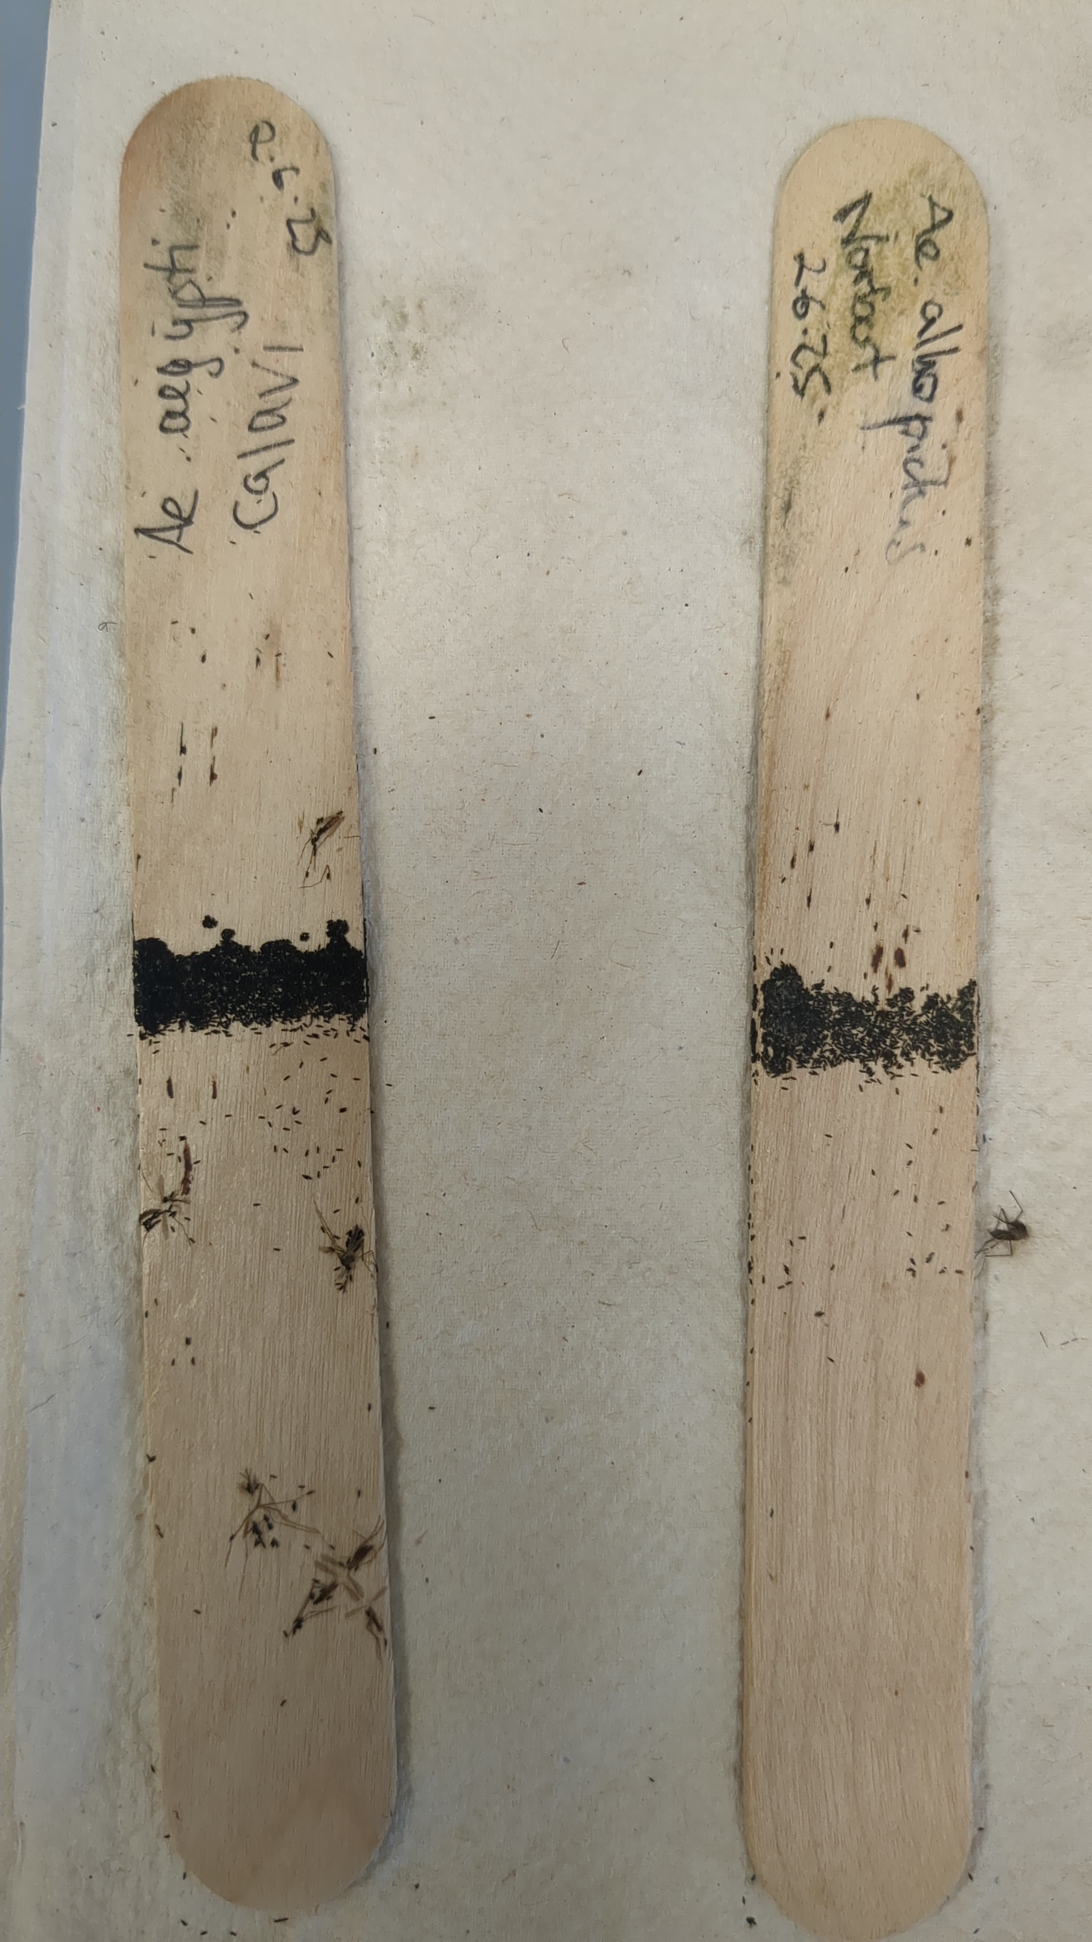
Image capture

Slide 5
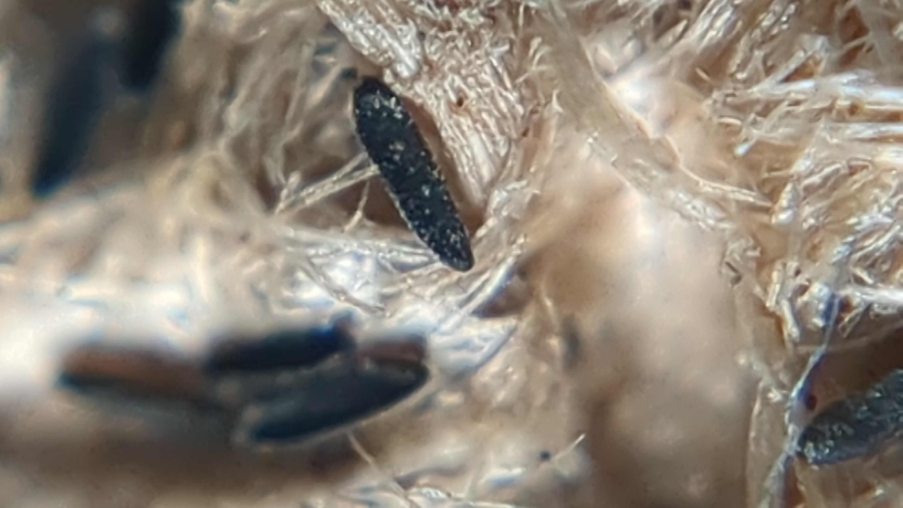
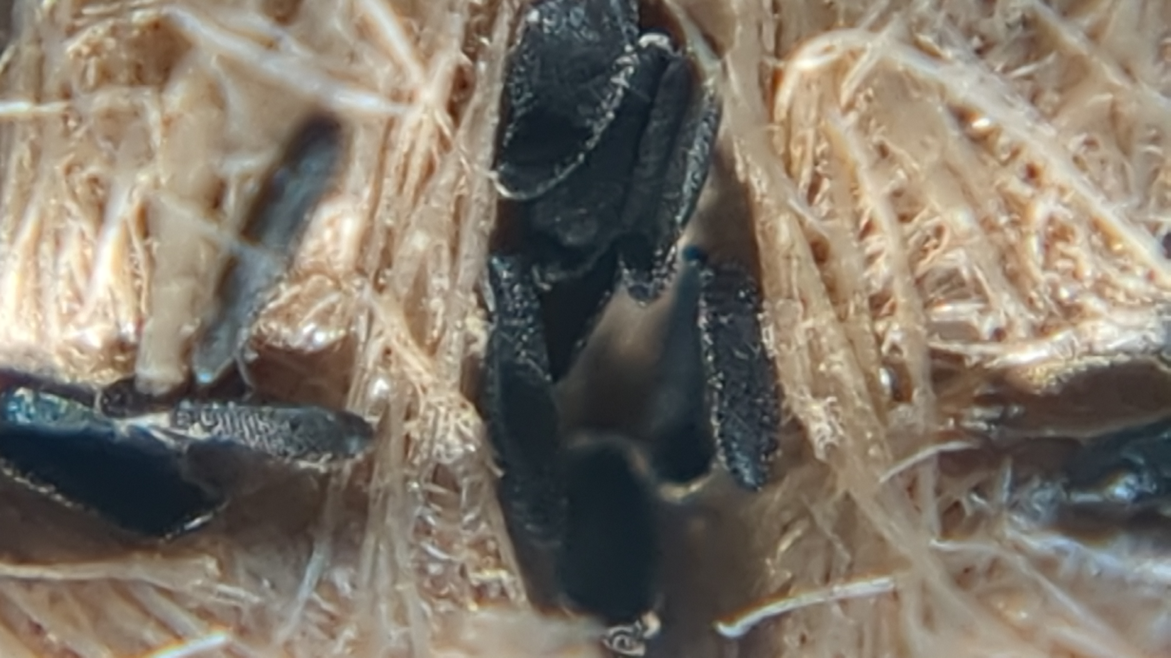
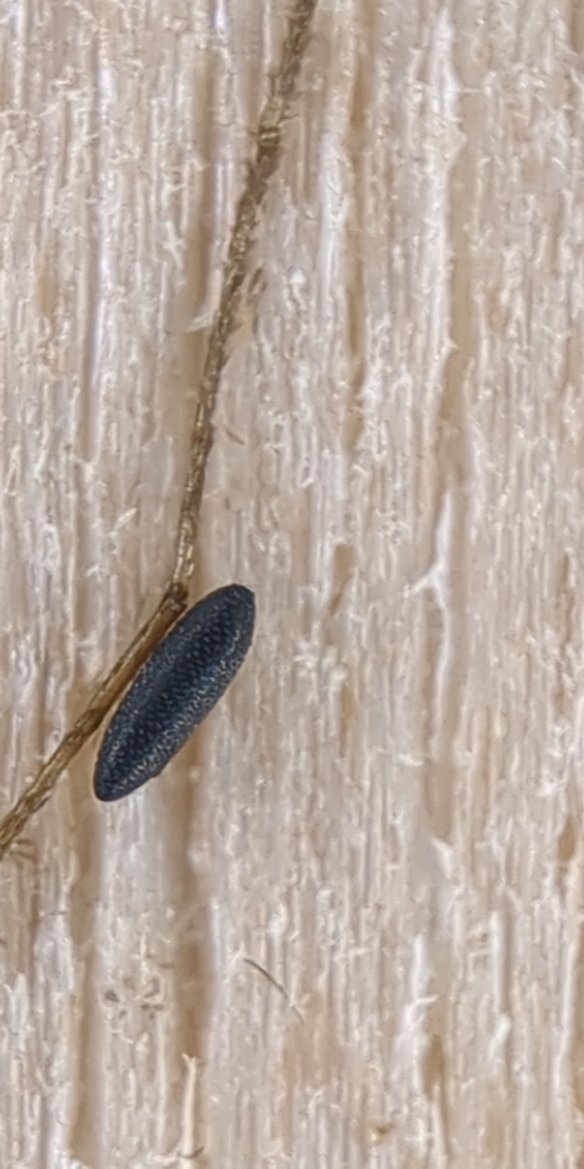
Image capture
Smartphone with 150x lens
Microscope
Smartphone with 24x lens

Slide 6
Image segmentation with Napari convpaint

Slide 7
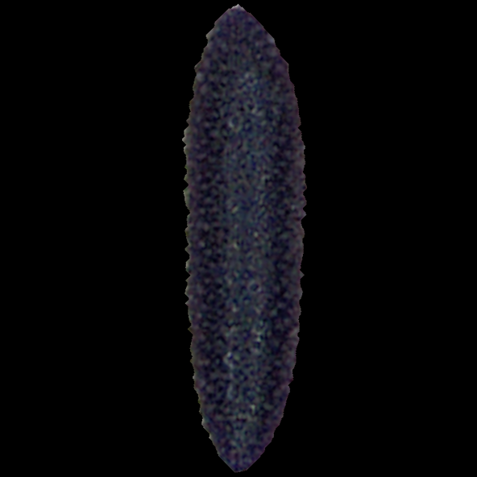
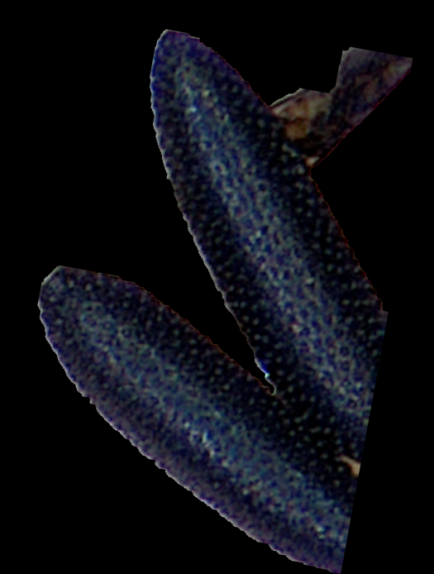
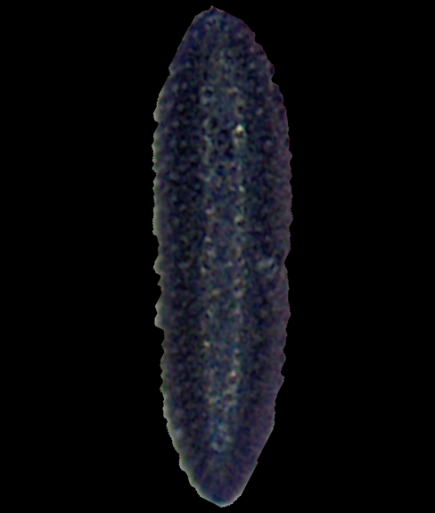
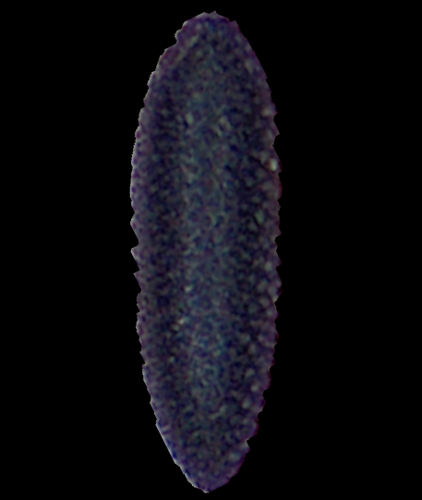
Image segmentation with Napari convpaint

Slide 8
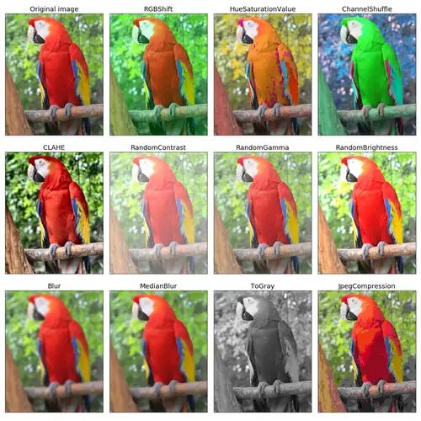
Image augmentation with Albumentation
Image augmentations
  Flip and rotate
  Brightness and contrast
  Color changes
  Blur
  Image noise
Improving generalization
https://albumentations.ai/

Slide 9
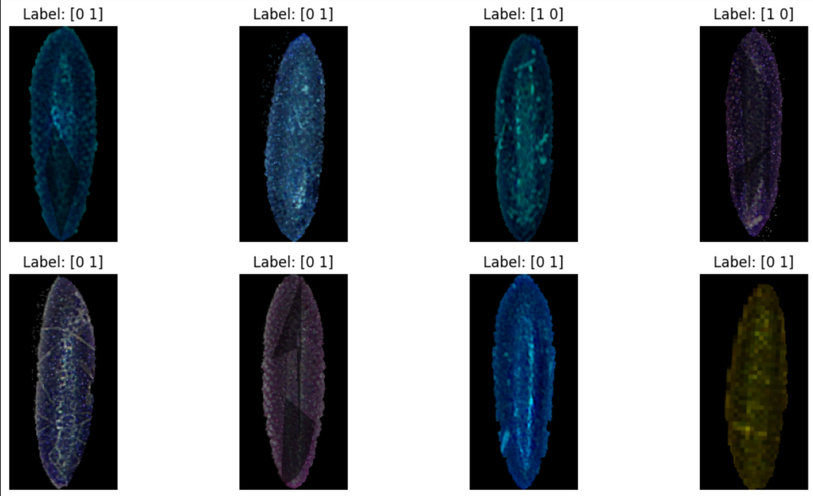
Image augmentation with Albumentation

Slide 10
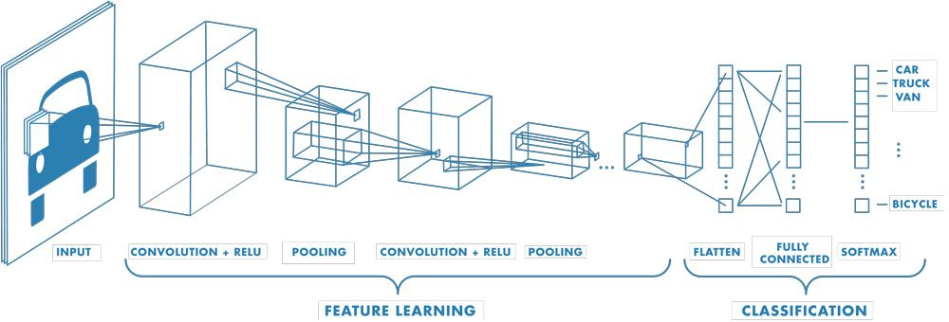
Egg classification with a convolutional neural network

Slide 11
Workflow
Image capture with microscope and smartphone
Image segmentation with Napari convpaint
Image augmentation with Albumentation
Egg classification with a convolutional neural network

Slide 12
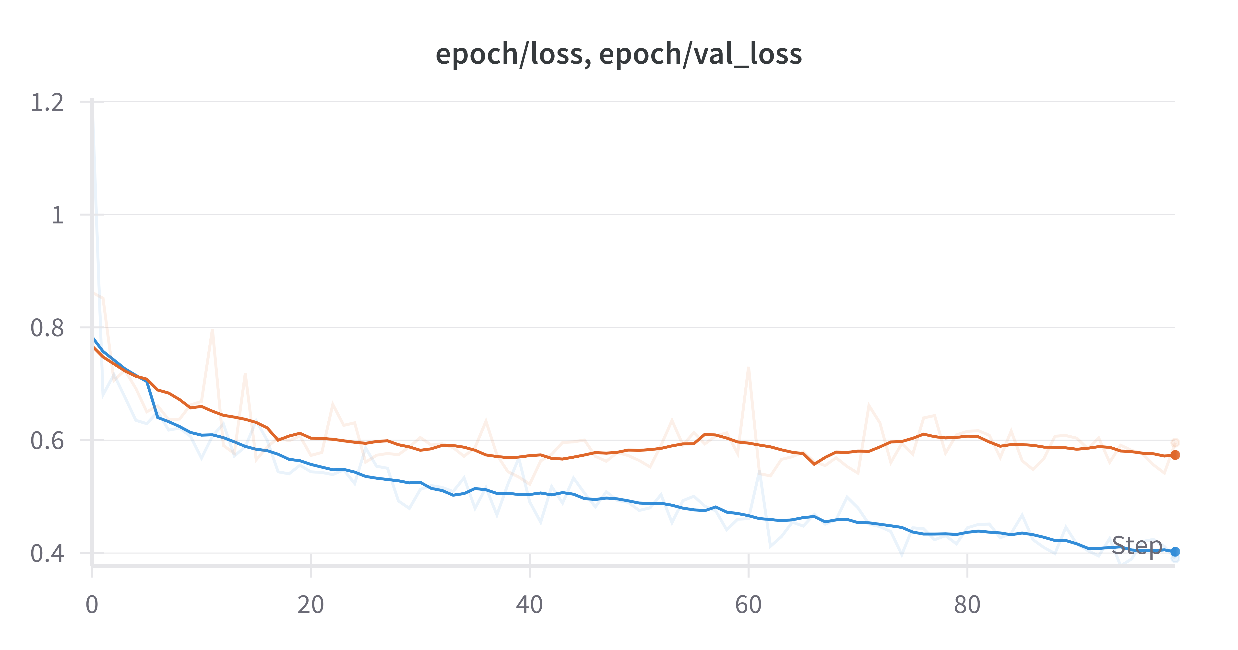
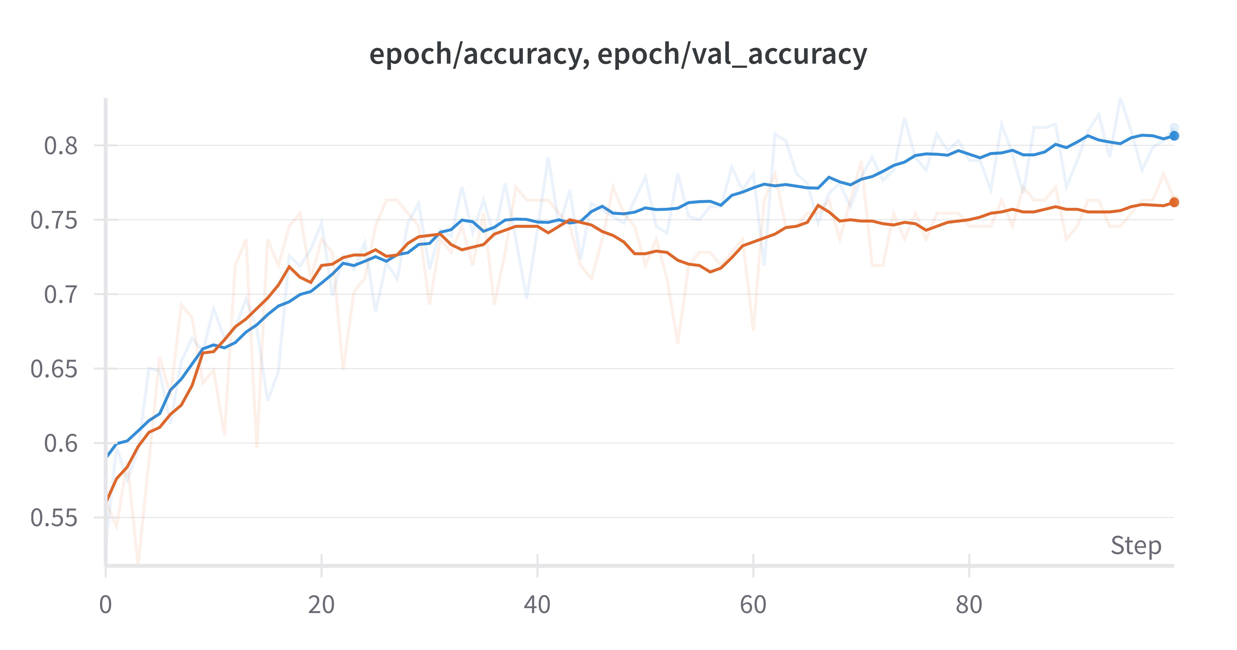
Results
Loss: 0.390
Validation loss: 0.595
accuracy: 0.812
Validation accuracy: 0.762

Slide 13
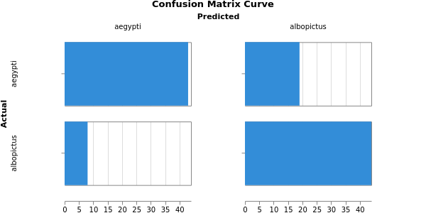
Results
43
19
8
44

Slide 14
What’s left to do
More images
Images from second device (smartphone)
Optimize CNN

